Slide 1
Stock price prediction model using ml
TEAM : MENTOR :
HARSHIMA SINGLA (16103030) PROF. ANOOP DOBHAL
SHIVAM JAND (16103100)
KARAN CHABA (16103121)

Slide 2
OBJECTIVE
Predict the stock market trend on day to day basis based on the past data
To add to the academic understanding of the stock market position
Help investors understand how the market has been moving in the past so as to well equip them for future trends

Slide 3
MOTIVATION
Predicting stock performance is a very large and profitable area of study
Many companies have developed stock predictors based on various machine learning algorithms
This technique has proven successful in aiding the decisions of investors
Can give an edge to beginning investors who don’t have a lifetime of experience

Slide 4
PROBLEM STATEMENT
Collect the dataset for stocks of a particular company
Apply various operations on the dataset and convert it to a form on which algorithms can be applied
Feed the dataset to the software, WEKA, where we apply various machine learning algorithms and compare the results for all the algorithms applied
Dataset is split up into 2 sets (percentage can be adjusted), one for learning and another for testing
Algorithm where the error for the predicted values is the minimum, is considered to give the best results and accuracy

Slide 5
DESIGN / IMPLEMENTATION
Collecting and optimizing dataset
- For this we chose the data of various Stock Prices, for a period of last 4 years
- Optimization of dataset
First we subtracted Previous day’s Open Price from Current day’s Open Price : OP(n) – OP(n-1)
If the difference was positive, we assigned it a Boolean variable TRUE, to mark increase in price, else FALSE :
IF(OP(n) – OP(n-1)>0, TRUE, FALSE)
This feature was named trend.
Also, we calculated Numeric Trend from the formula below:
(OP(n) – OP(n-1))*1000/OP(n-1)

Slide 6
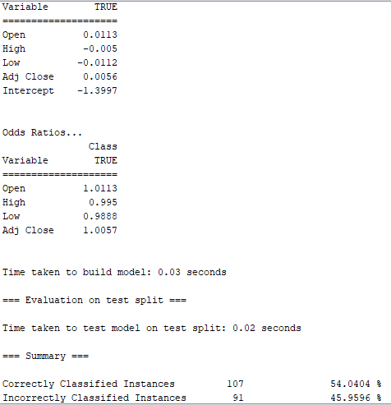
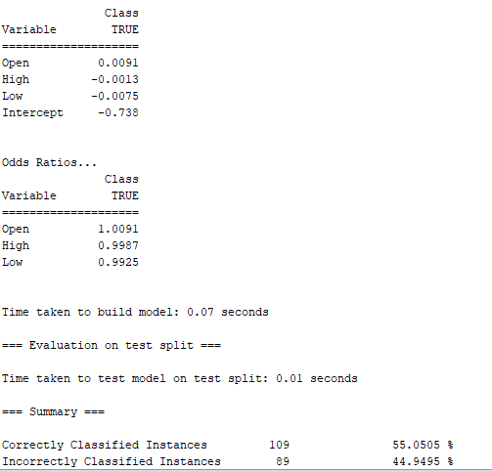
.
Feed the optimized dataset to the software WEKA in the form of a CSV file.
- Select dataset from your local device, algorithm to apply and partition %
- Get the error values (accuracy %) for each algorithm and compare them.
Logistic Regression :

Slide 7
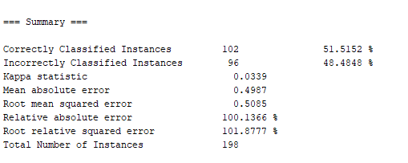
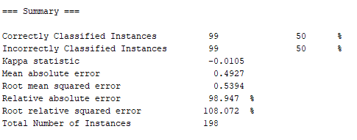
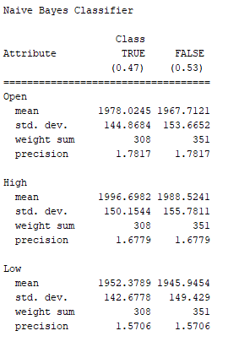
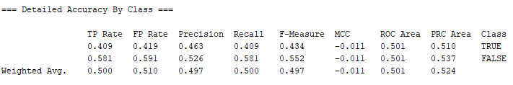
.
Naïve Bayes :
Random Forrest:

Slide 8
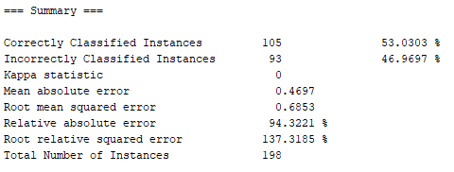
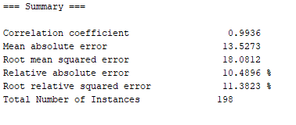
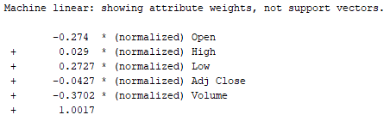
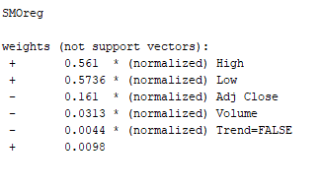
SVM
But when SVM applied on Open Price**

Slide 9
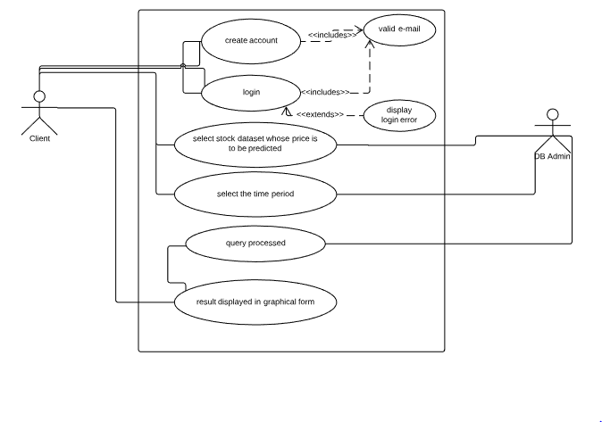
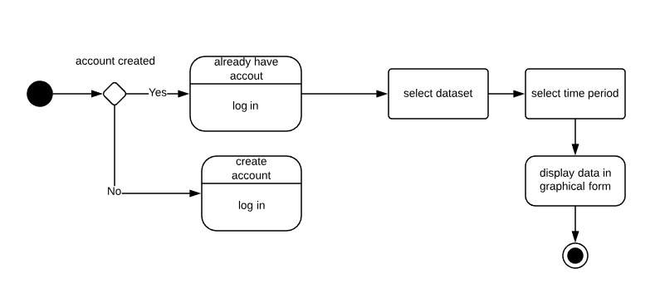
Use case diagram and Activity diagram

Slide 10
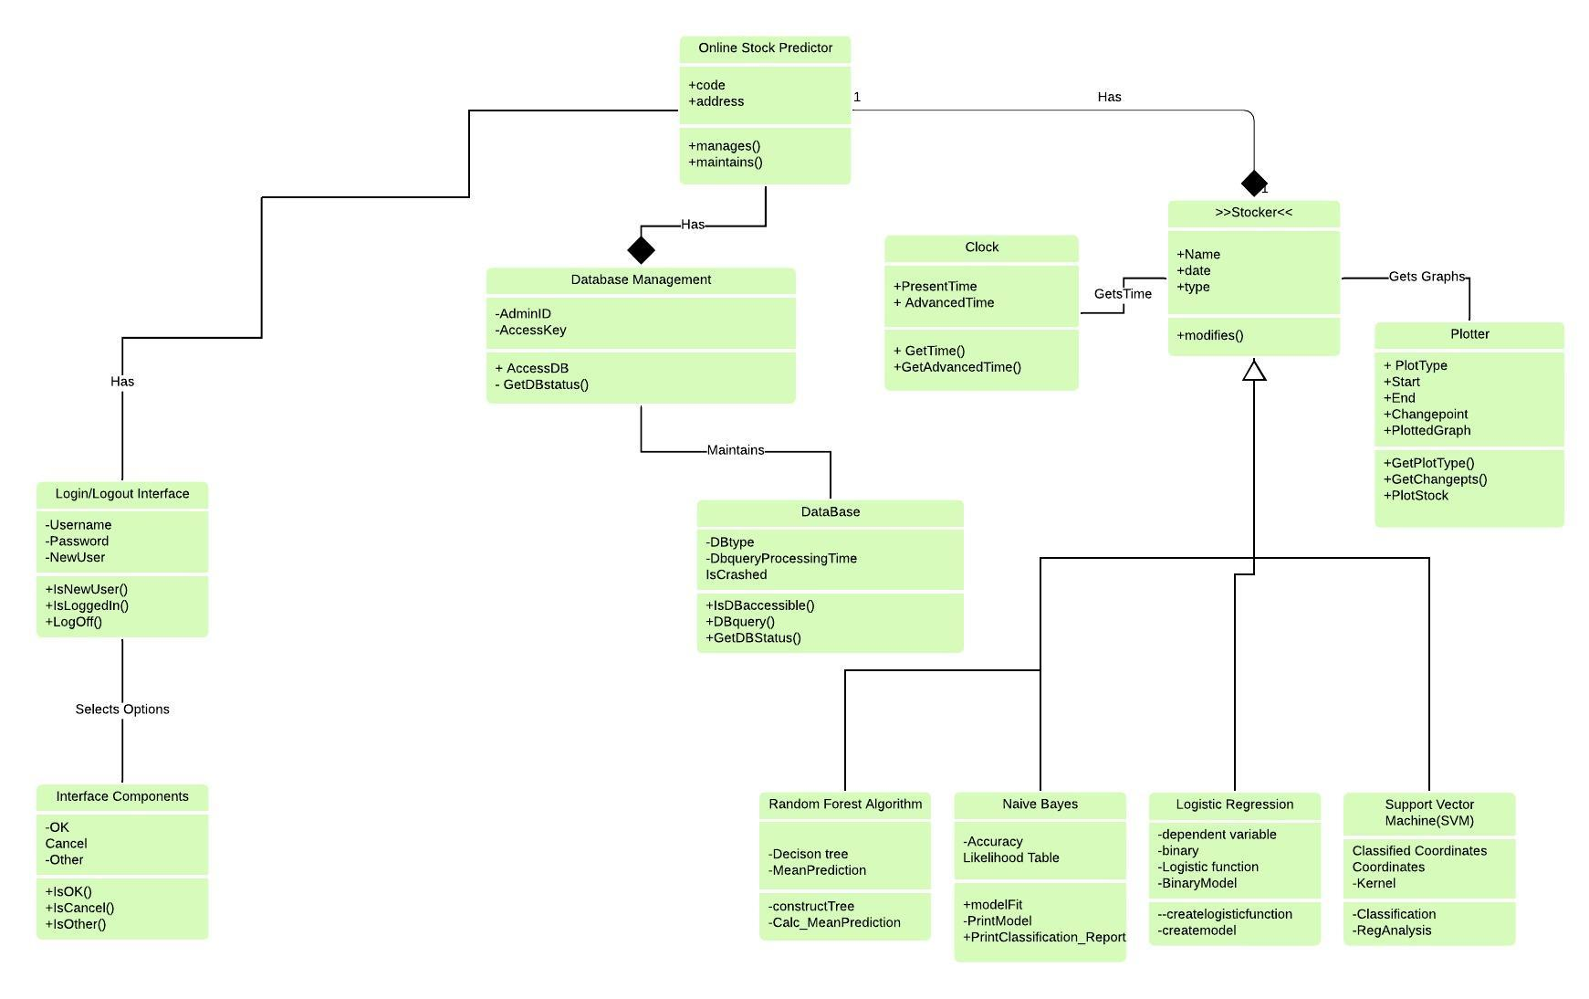
Class diagram

Slide 11
Results achieved so far
Collected data of stock prices of various companies using Yahoo Finance
We added new features in our data like Trend using already present features to enhance its capabilities
Used method of trial and error to preprocess the data for different algorithms
Applied different algorithms with different testing methods, comparing their accuracy in different methods

Slide 12
Conclusion
SVM algorithm gives the most accurate results for the prediction
The more the percentage of dataset split in the learning section, the more accurate the results are for the testing section

Slide 13
Timeline for further work
Implementing the above concepts through Python
Providing a frontend to the implement this in the form of a web application
In the application, the client will be able to select the stock whose future price is to be predicted and the time for which the piece is to be predicted
The results will be visible in graphical form using different algorithms and thus the client will get a fair idea about how the price will change and can invest accordingly

